Slide 1
Tour of New York!

Slide 2
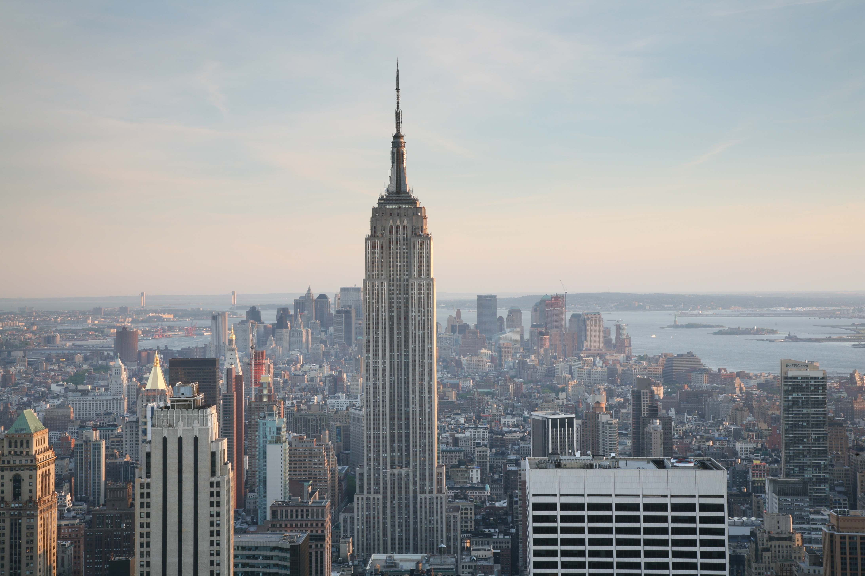

Empire State Building
Move: Empire Stretch
Notes:
https://commons.wikimedia.org/wiki/File:NYC_Empire_State_Building.jpg

Slide 3
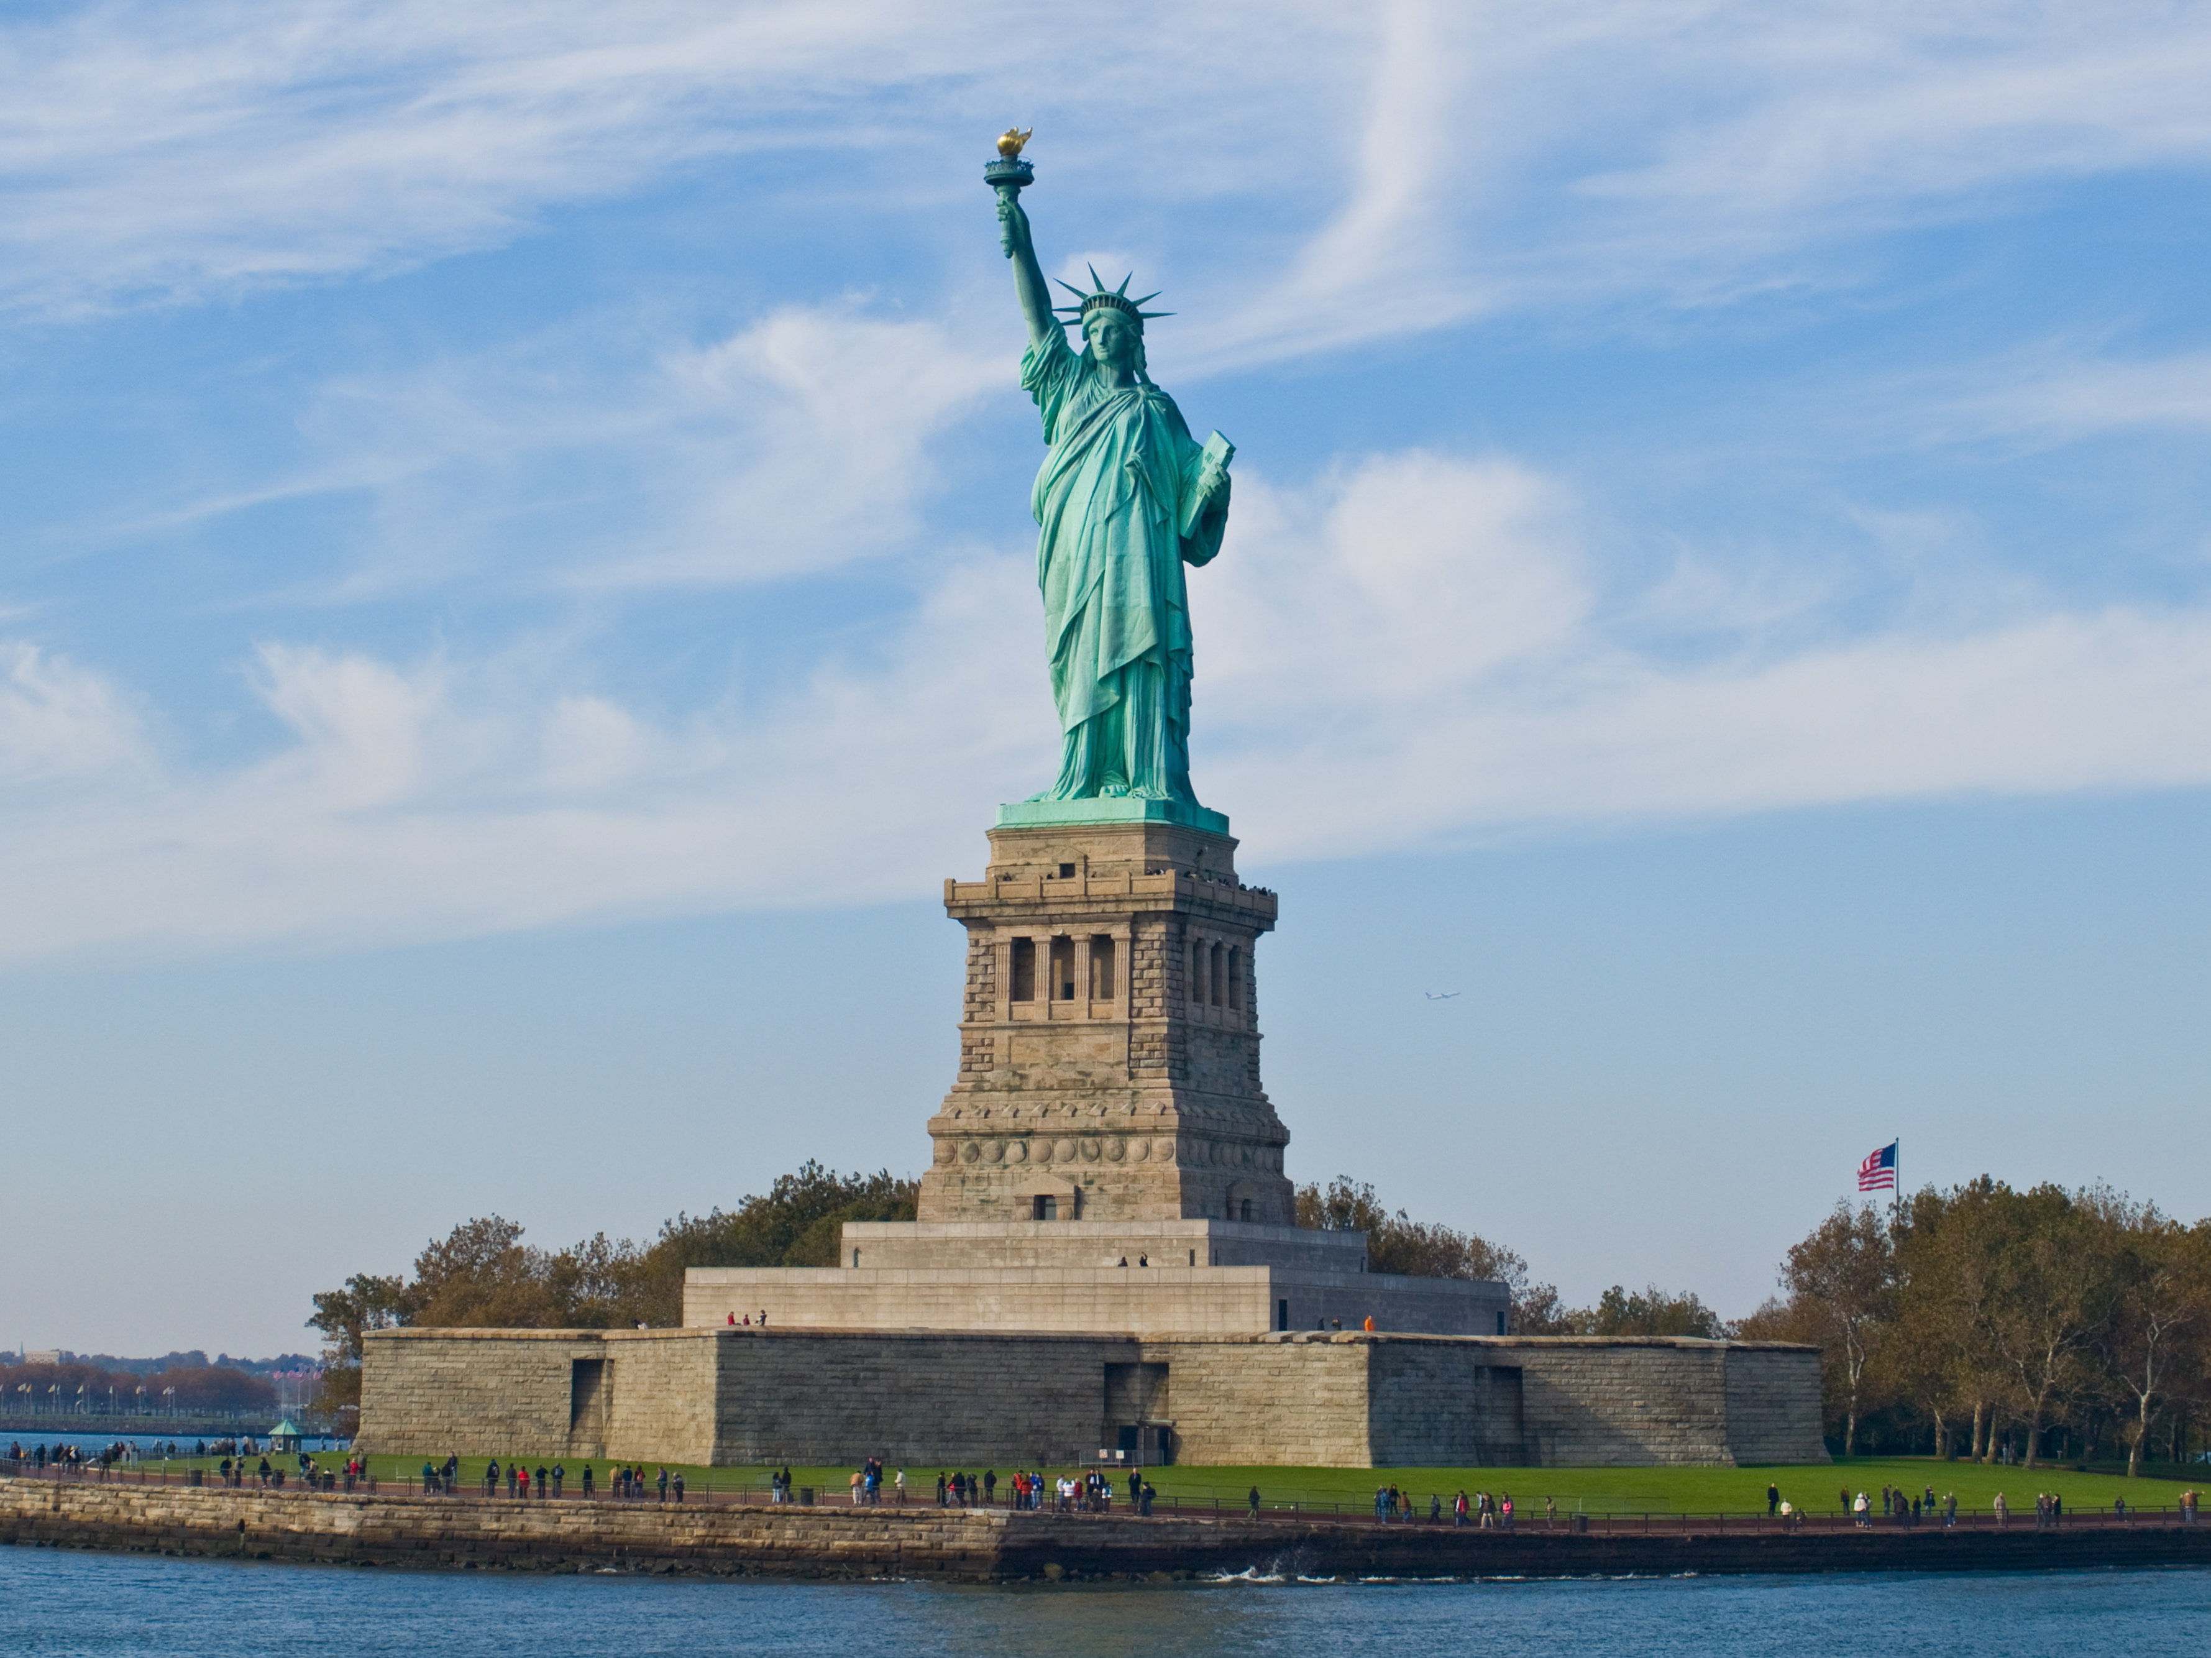
Statue of Liberty
Move: Statue Pose
Notes:
https://commons.wikimedia.org/wiki/File:Statue_of_Liberty,_NY.jpg

Slide 4
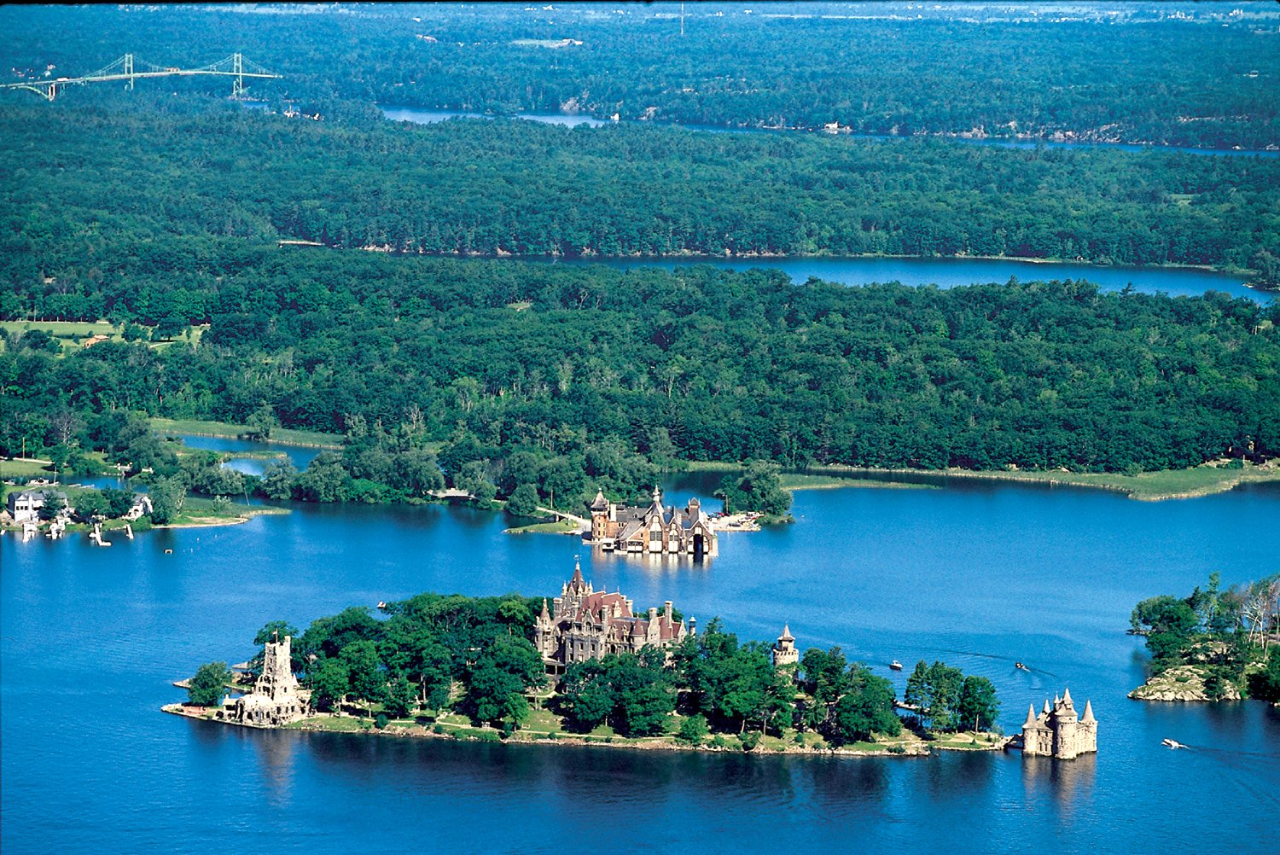
Thousand Islands
Move: River Swimming
Notes:
https://upload.wikimedia.org/wikipedia/commons/3/3b/BoldtCastle_aerial.jpg

Slide 5
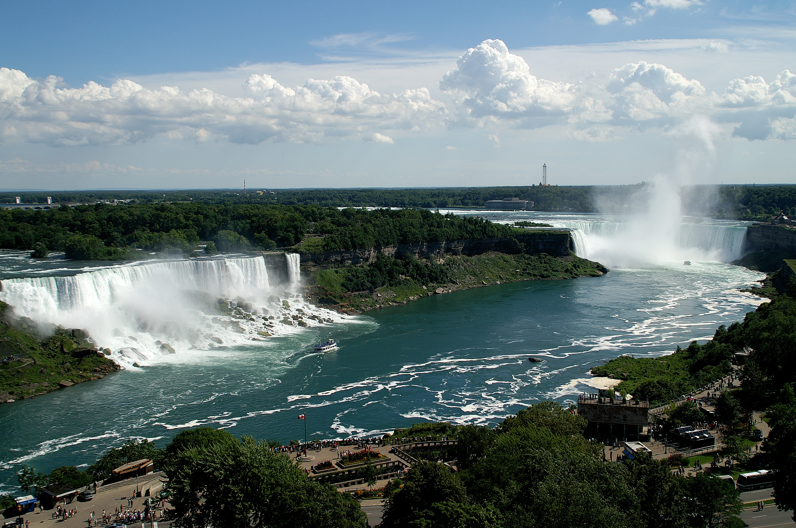
Niagara Falls
Move: Make a Waterfall
Notes:
https://en.wikipedia.org/wiki/Niagara_Falls

Slide 6
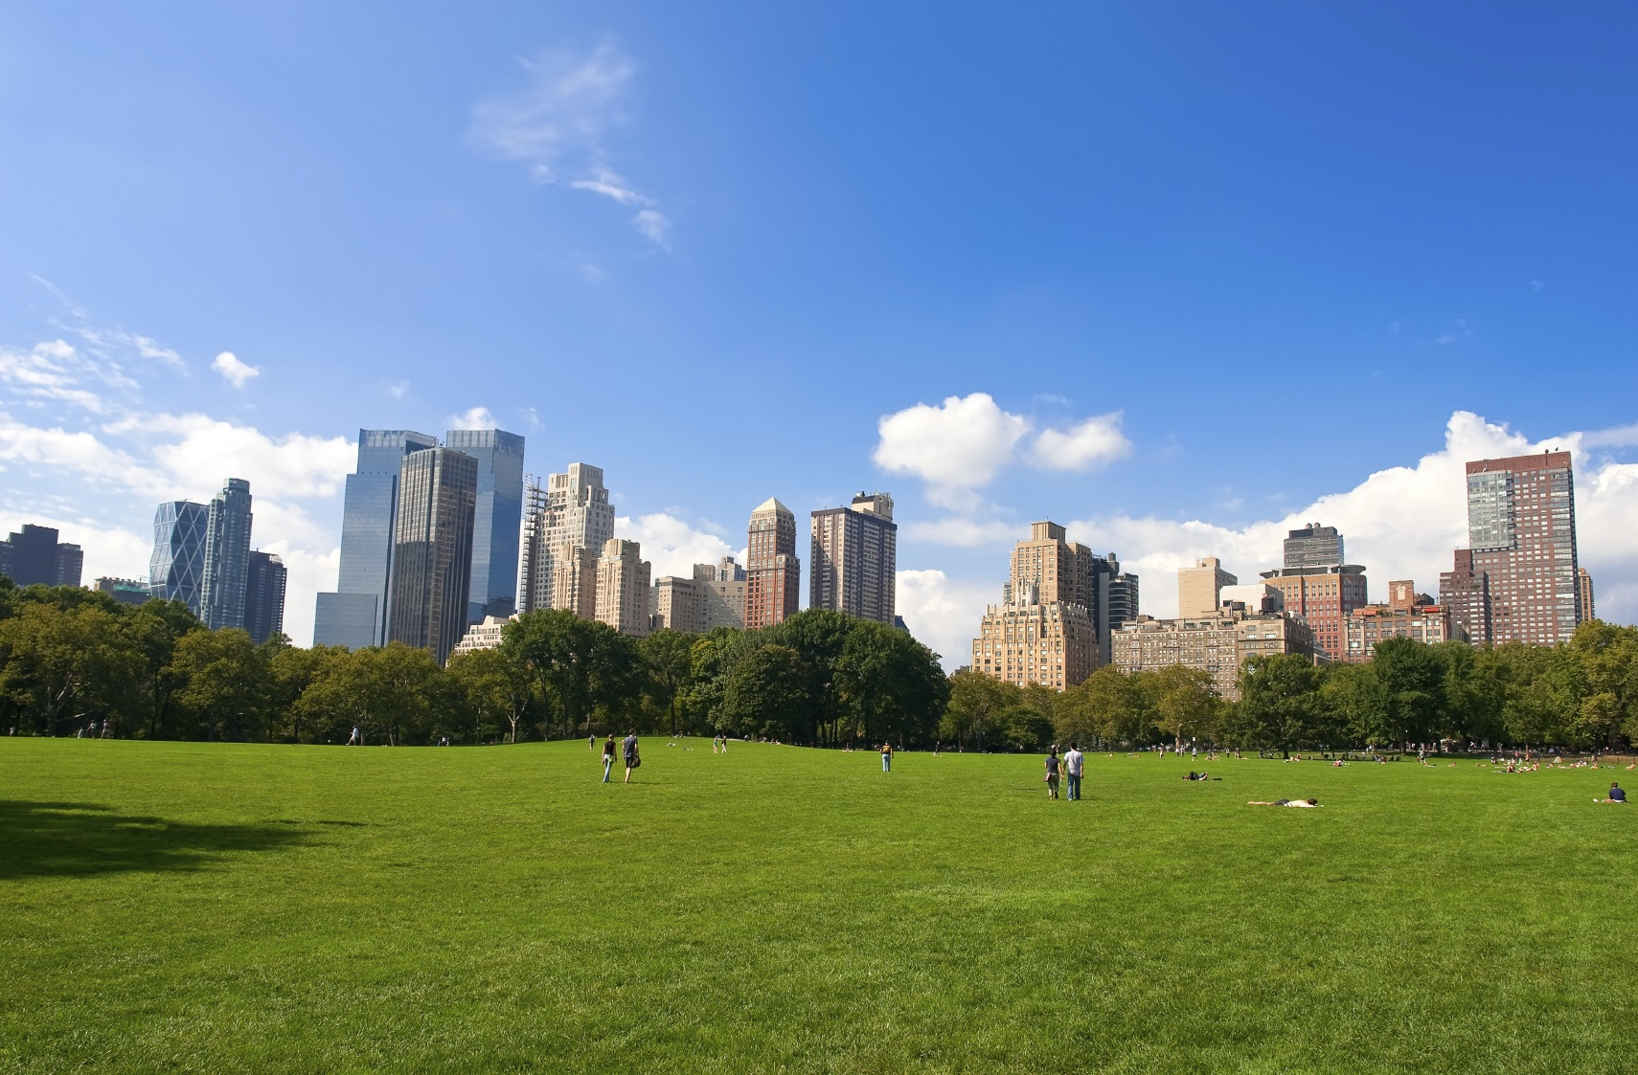
Central Park
Move: Jog
Notes:
http://www.737parkavenuenyc.com/july-events-in-central-park

Slide 7
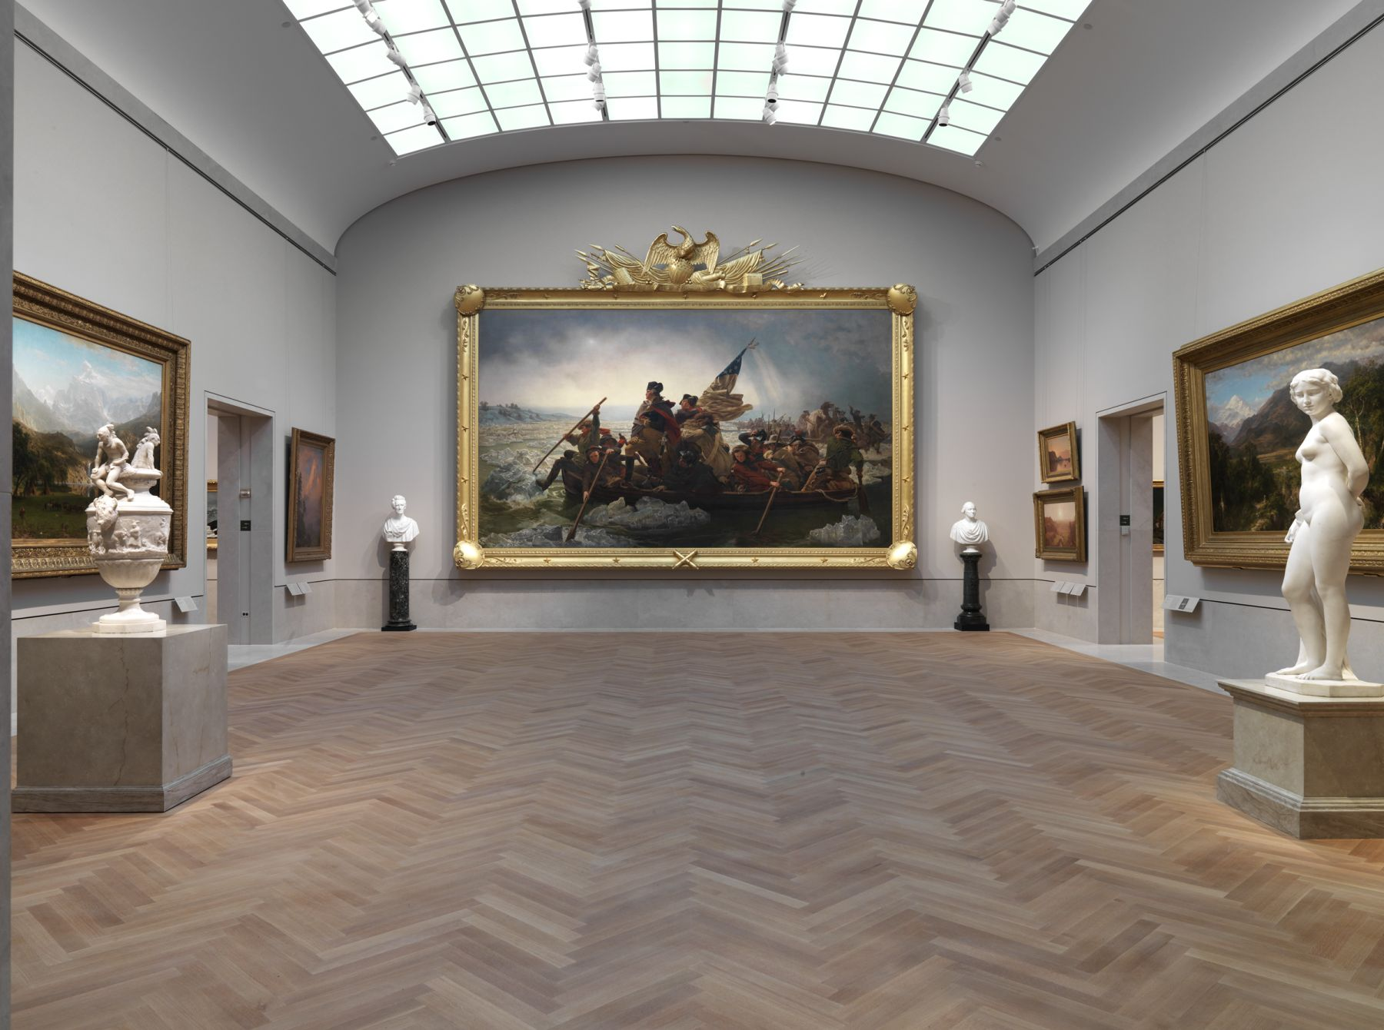
Metropolitan Museum of Art
Move: Observing Art
Notes:
https://leonardtoddconversations.files.wordpress.com/2012/03/gallery-760_history-landscape-and-national-identity_view-1.jpg

Slide 8
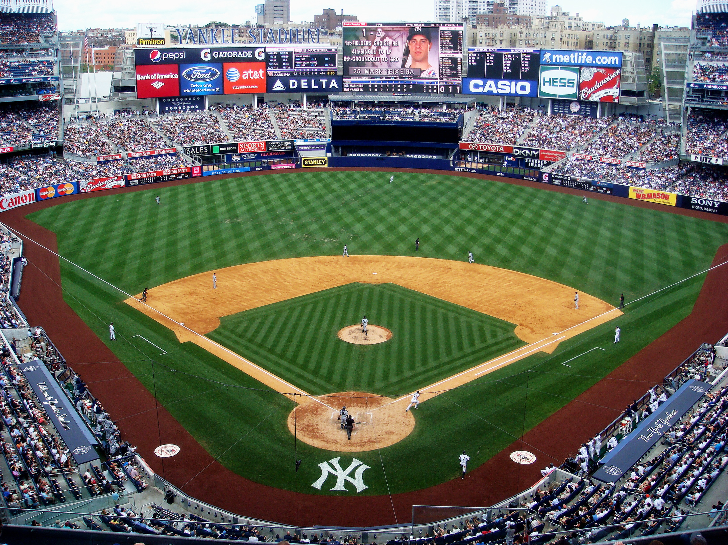
Yankee Stadium
Move: Opening Pitch
Switch Sides!
Notes:
https://upload.wikimedia.org/wikipedia/commons/4/44/Yankee_Stadium_upper_deck_2010.jpg

Slide 9
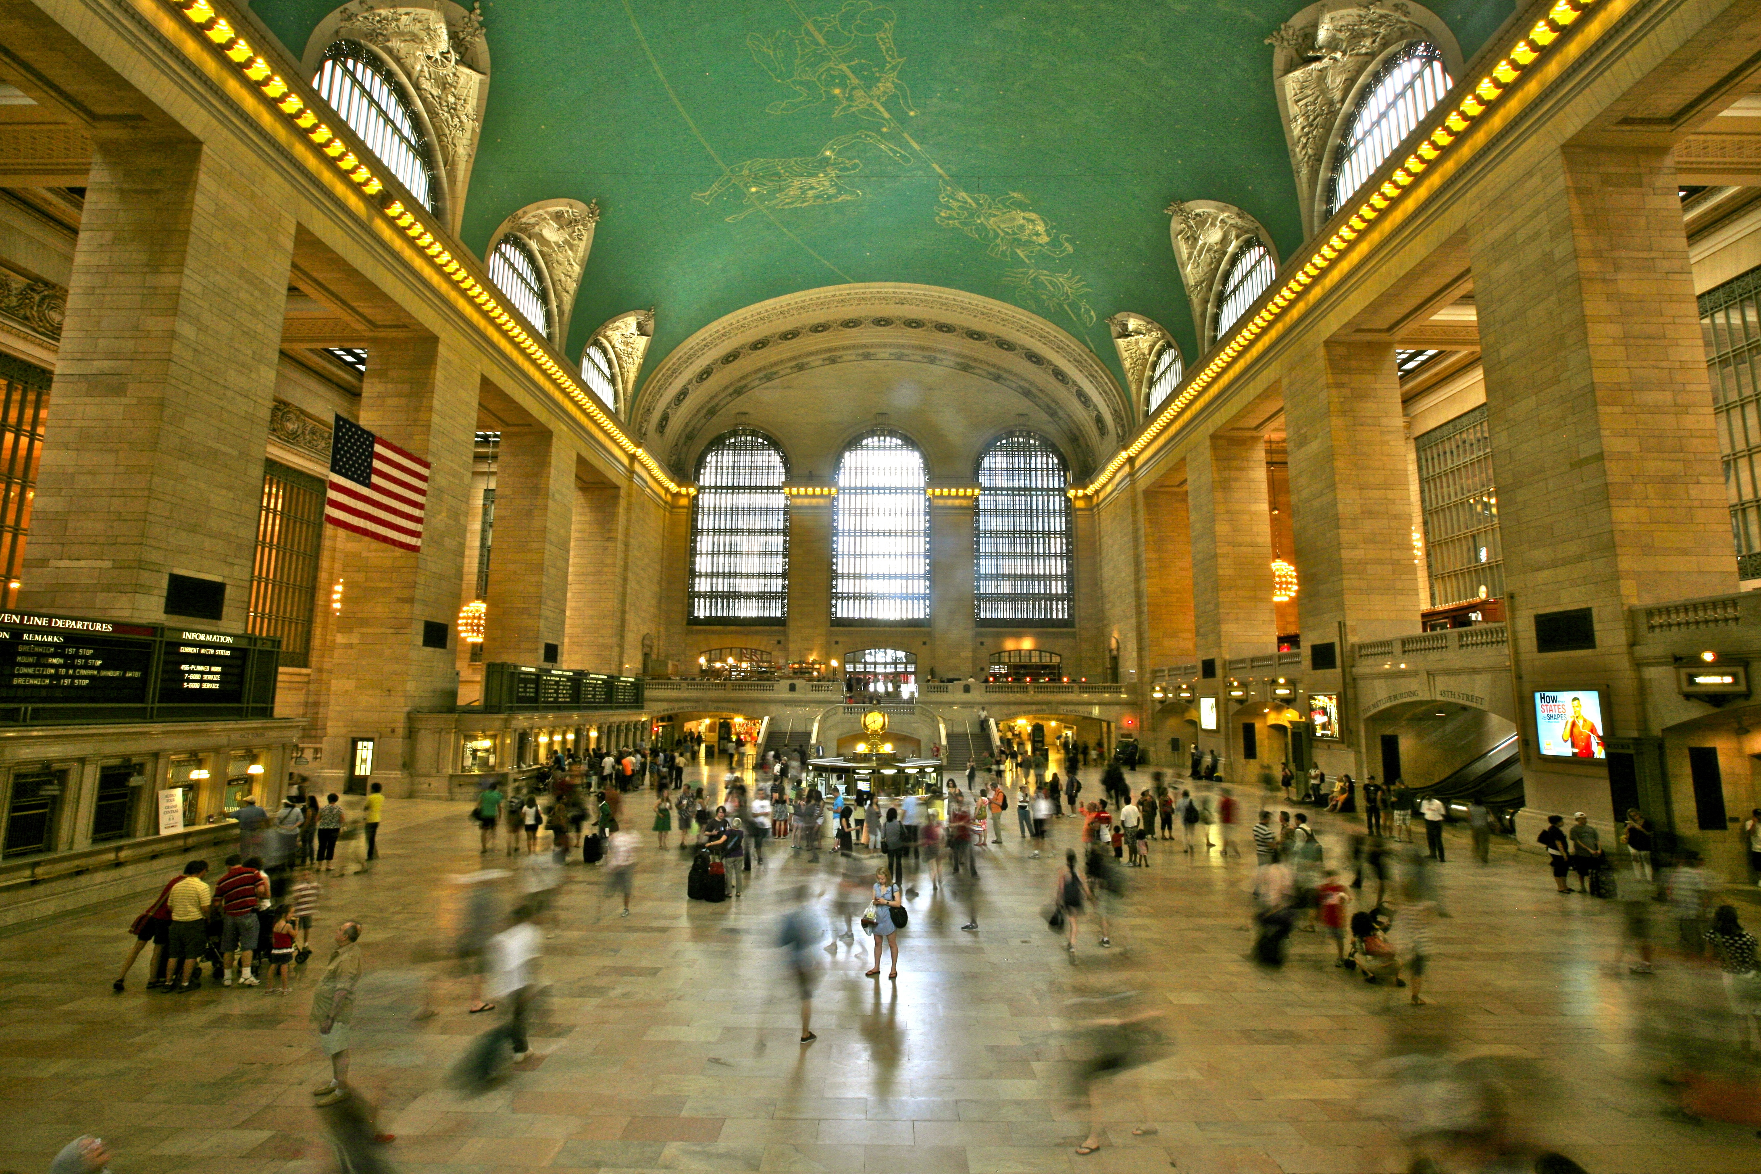
Grand Central Terminal
Move: Toot the Horn
Notes:
https://upload.wikimedia.org/wikipedia/commons/d/d0/Grand_Central_Terminal,_New_York_City_(5903663780).jpg

Slide 10
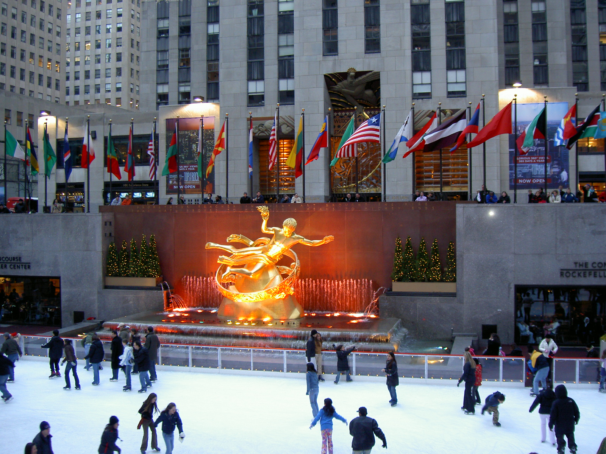
Rockefeller Center
Move: Iceskate
Notes:
https://upload.wikimedia.org/wikipedia/commons/1/11/Rockefeller_Center_(2006).JPG

Slide 11
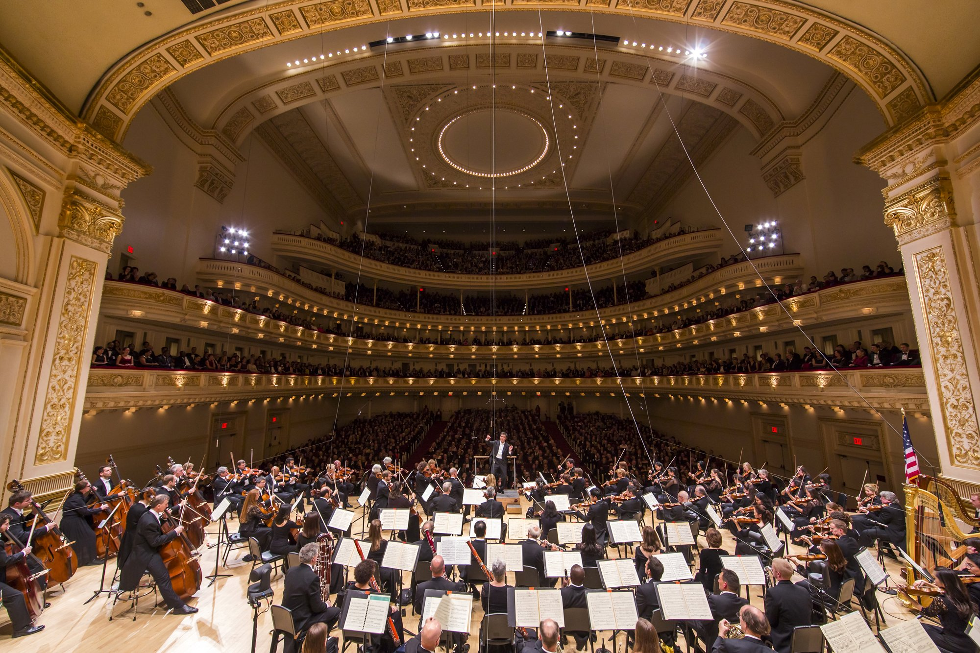
Carnegie Hall
Move: Opera Conductor
Notes:
http://media.vogue.com/r/c_1,h_4000,w_3280/2015/10/08/scene-performance.jpg

Slide 12
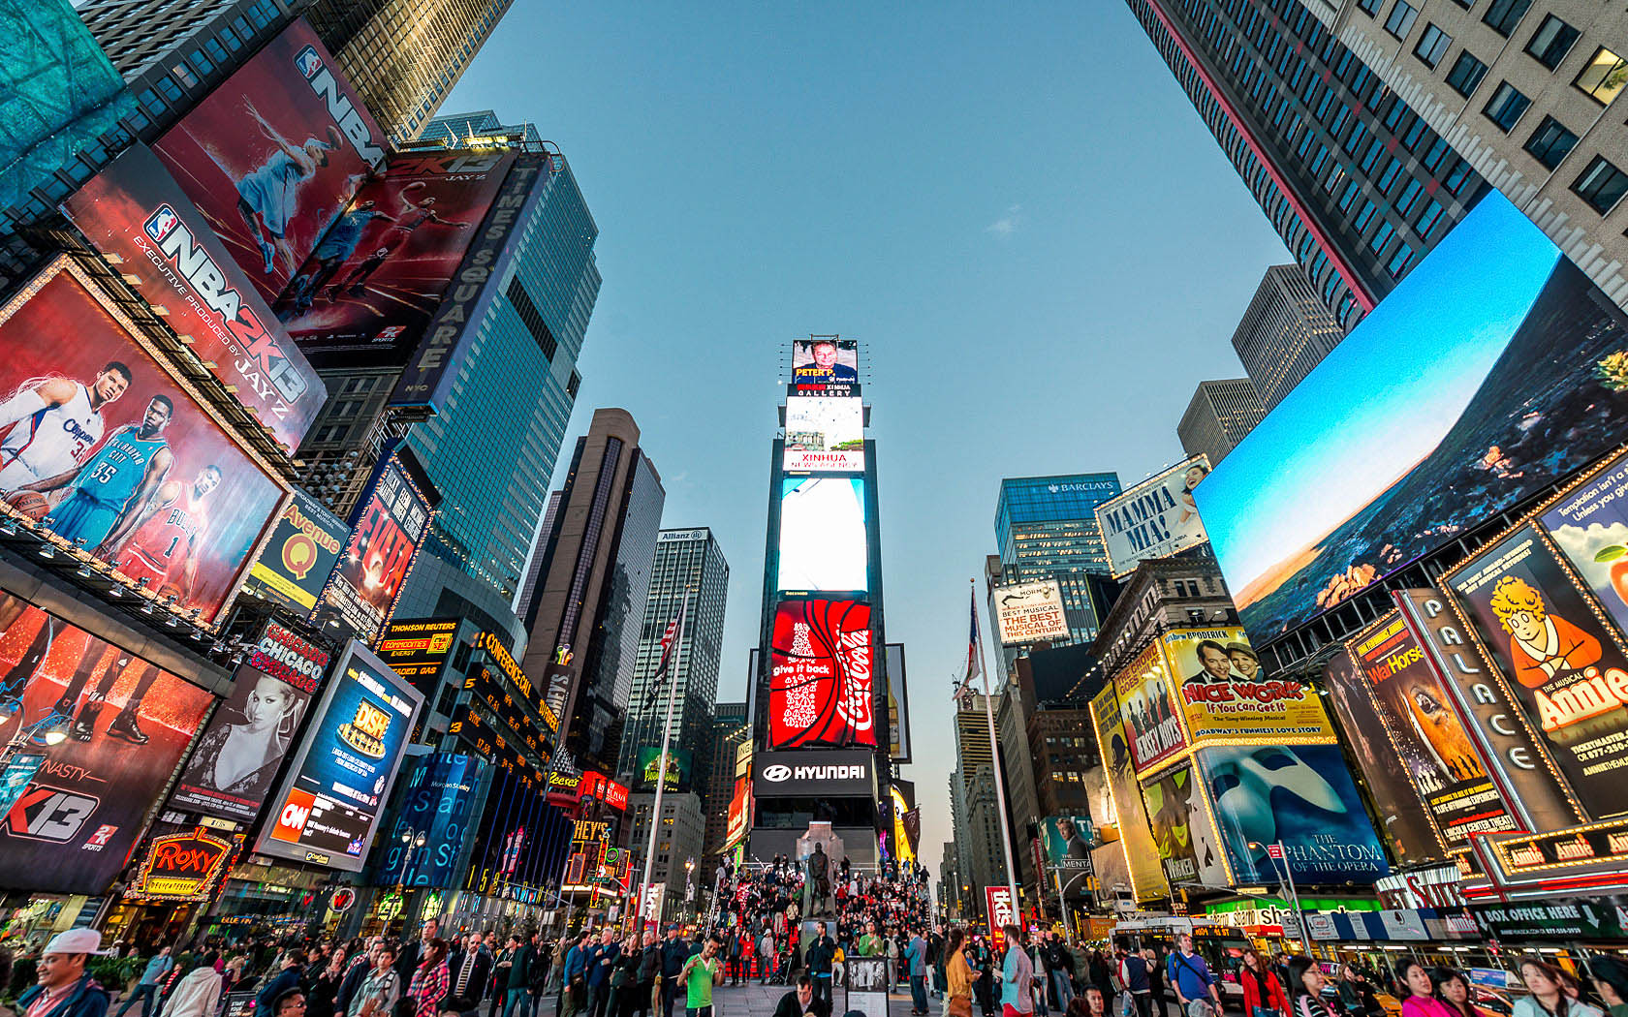
Times Square
Move: Call a Cab
Notes:
http://www.manhattanhoteltimessquare.com/public_docs/manhattan/gallery/Manhattan-Hotel-Times-Square-NYC-15.jpg

Slide 13
Freestyle!

Slide 14
Great job!

